Slide 1
PLANTS AND ANIMALS
Random plant and animal topics you need to know
*** NOTE: These are in addition to the nervous and immune systems

Slide 2
HEART CHAMBERS – Animals have different numbers of chambers Fish have 2-chambered hearts

Slide 3
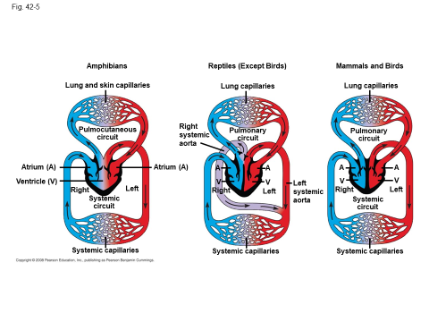

Slide 4
Organisms use various strategies to regulate body temperature and metabolism. Thermoregulation is the process by which animals maintain an internal temperature within a tolerable range

Slide 5
Endothermy and Ectothermy
Endothermic animals generate heat by metabolism; birds and mammals are endotherms
Ectothermic animals gain heat from external sources; ectotherms include most invertebrates, fishes, amphibians, and non-avian reptiles
Copyright © 2008 Pearson Education, Inc., publishing as Pearson Benjamin Cummings

Slide 6
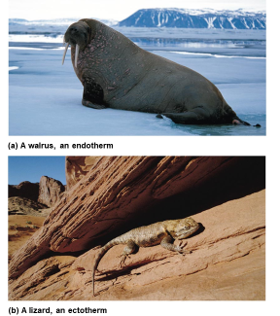

Slide 7
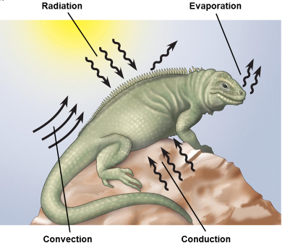

Slide 8
There is a relationship between metabolic rate per unit body mass and the size of multicellular organisms — generally, the smaller the organism, the higher the metabolic rate.
Metabolic rate is the amount of energy an animal uses in a unit of time

Slide 9
Size and Metabolic Rate
Metabolic rate per gram is inversely related to body size among similar animals
The higher metabolic rate of smaller animals leads to a higher oxygen delivery rate, breathing rate, heart rate, and greater (relative) blood volume, compared with a larger animal
Basal metabolic rate (BMR) is the metabolic rate of an endotherm at rest at a “comfortable” temperature
Copyright © 2008 Pearson Education, Inc., publishing as Pearson Benjamin Cummings

Slide 10
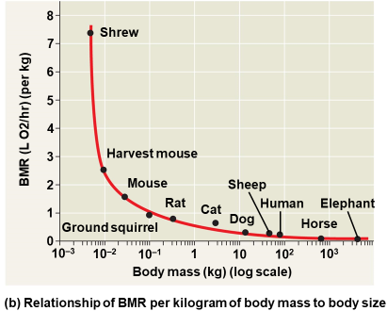

Slide 11
As cells increase in volume, the relative surface area decreases and demand for material resources increases; more cellular structures are necessary to adequately exchange materials and energy with the environment. These limitations restrict cell size.

Slide 12
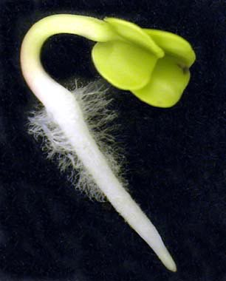
Examples
Root hairs in plants increase surface area
for water and nutrient uptake
Villi and microvilli of intestine increase
surface for diffusion of water and food

Slide 13
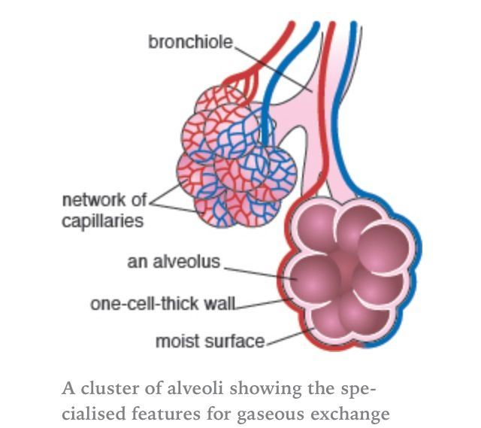
Cells of the
alveoli in lungs

Slide 14
Organisms also have feedback mechanisms that maintain dynamic homeostasis by allowing them to respond to changes in their internal and external environments. Negative feedback loops maintain optimal internal environments, and positive feedback mechanisms amplify responses.

Slide 15
. Negative feedback mechanisms maintain dynamic homeostasis for a particular condition (variable) by regulating physiological processes, returning the changing condition back to its target set point.

Slide 16
For example: Operons in bacteria

Slide 17
Temperature regulation in animals

Slide 18
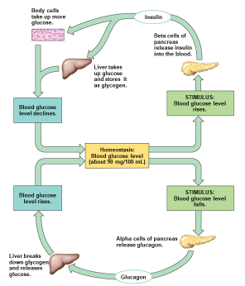
Blood glucose concentration

Slide 19
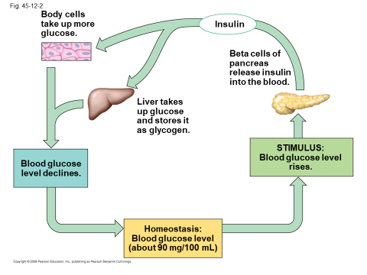

Slide 20
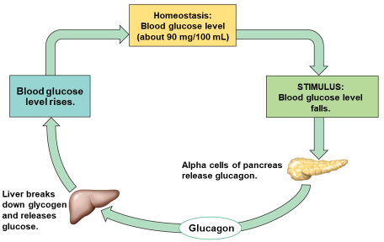

Slide 21
Positive feedback mechanisms amplify responses and processes in biological organisms. The variable initiating the response is moved farther away from the initial set-point. Amplification occurs when the stimulus is further activated which, in turn, initiates an additional response that produces system change.

Slide 22
For example: Labor during childbirth

Slide 23
Another example of positive feedback: Ripening of fruit

Slide 24
Alteration in the mechanisms of feedback often results in deleterious consequences.
Diabetes mellitus for example – hormones insulin and glucagon can not maintain a level glucose concentration in the blood

Slide 25
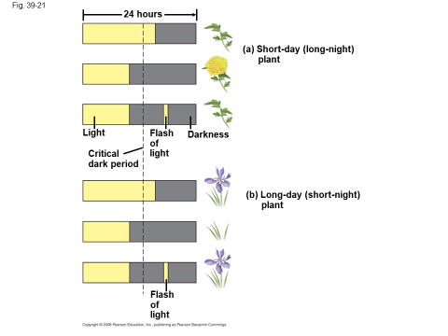
Organisms respond to changes in their environment through behavioral and physiological mechanisms.
For example:
Photoperiodism in plants

Slide 26
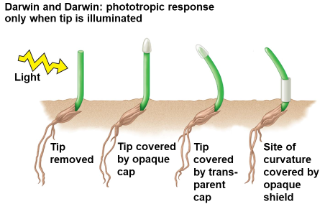
Phototropism in plants

Slide 27
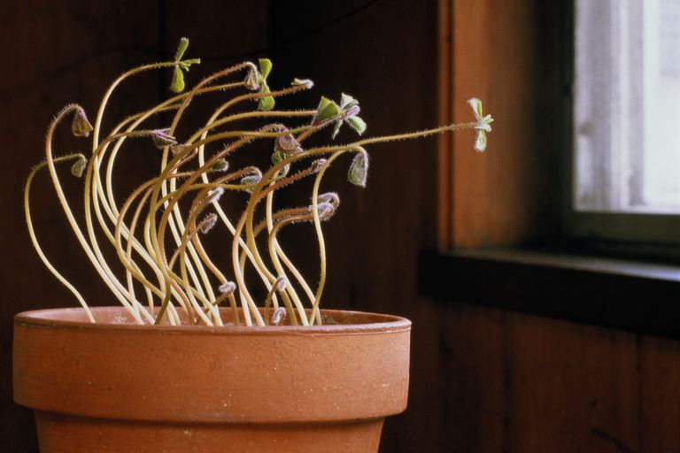
NOTE: Don’t confuse photoperiodism with phototropism!
This is photoTROPISM

Slide 28
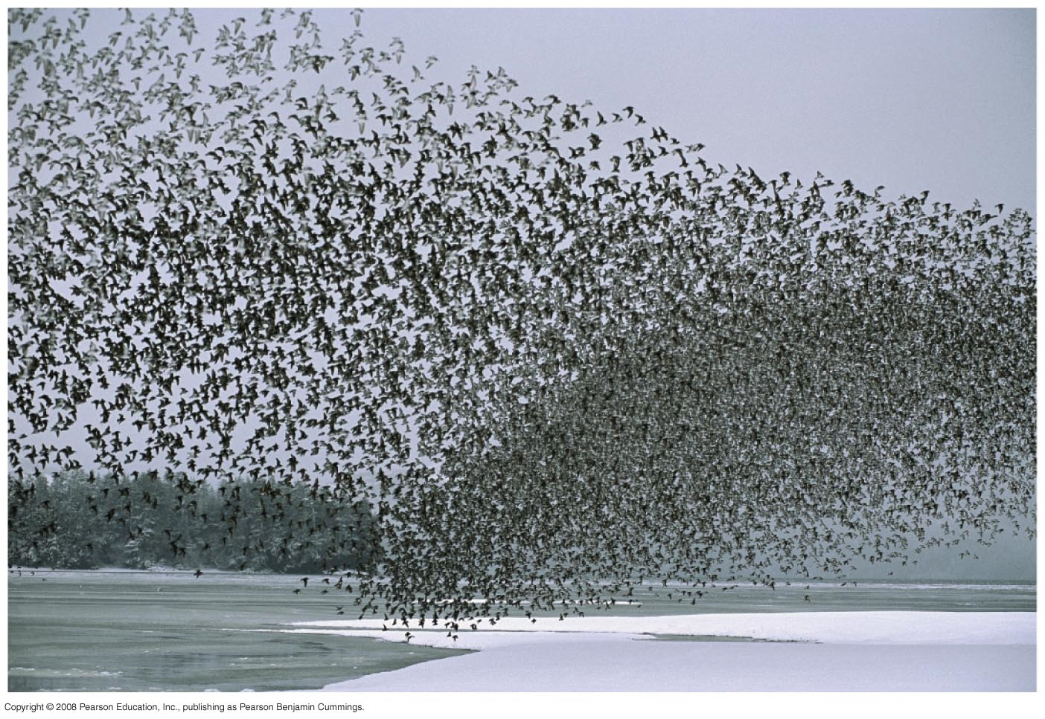
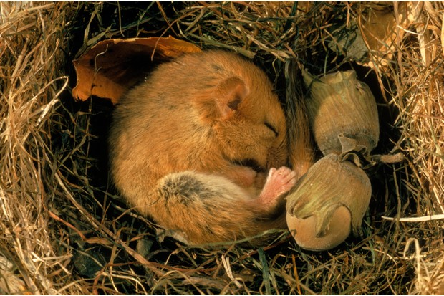
Hibernation and migration in animals

Slide 29
Taxis and kinesis in animals

Slide 30
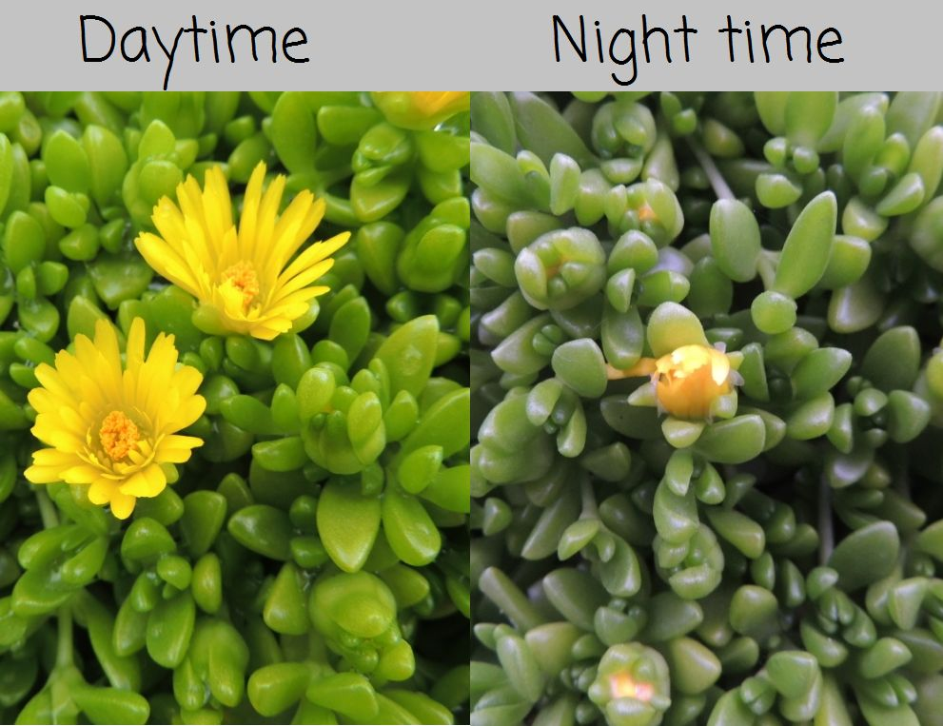
Nocturnal and diurnal activity: circadian rhythms

Slide 31
Organisms have various mechanisms for obtaining nutrients and eliminating wastes.

Slide 32
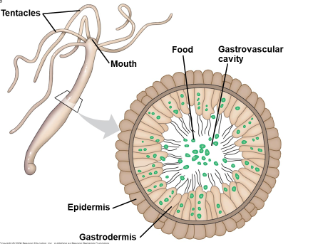
A hydra has one opening of its digestive system, so food and wastes use the same opening (two-way digestion)

Slide 33
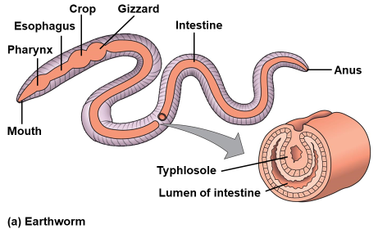
An earthworm has a separate opening for food waste (one way digestion)

Slide 34
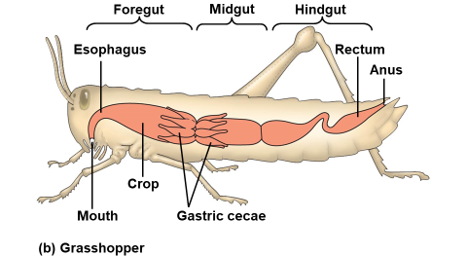

Slide 35
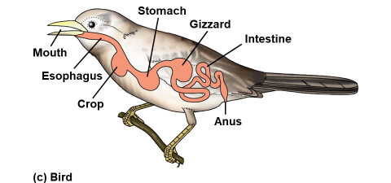

Slide 36
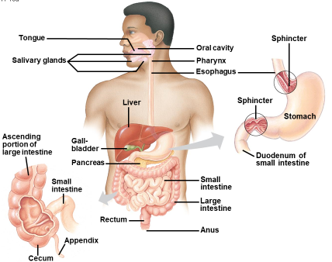

Slide 37
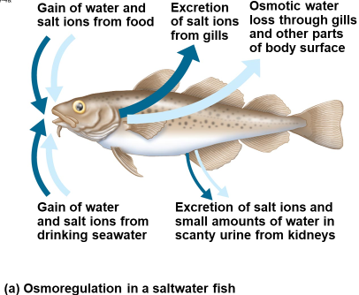

Slide 38
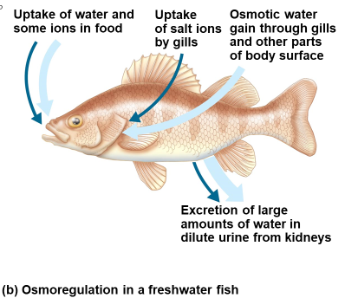

Slide 39
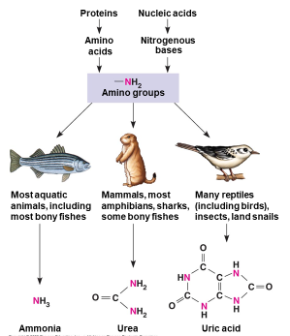
Animals eat protein and the amino groups broken off amino acids are toxic. Fish excrete it as ammonia. Mammals excrete it as urea. Reptiles and birds excrete it as uric acid.

Slide 40
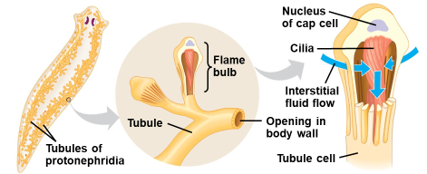
A flatworm has nephridia to excrete waste

Slide 41
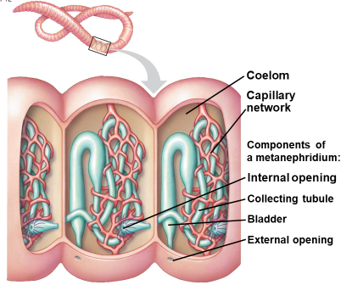
So do earthworms

Slide 42
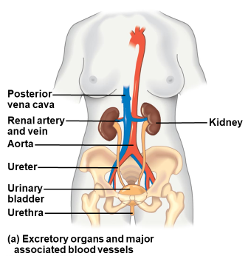
Humans have kidneys to get rid of urea

Slide 43
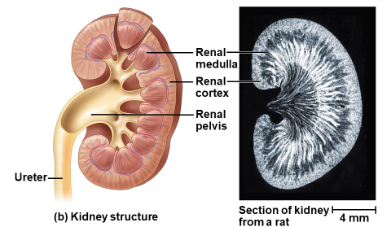

Slide 44
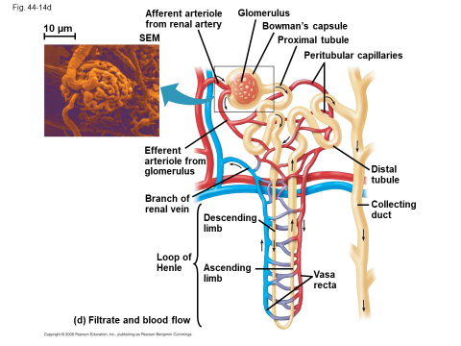
Urea is filtered from the blood in microscopic tubes called nephrons in the human kidney. Osmotic balance of blood is also regulated there.

Slide 45
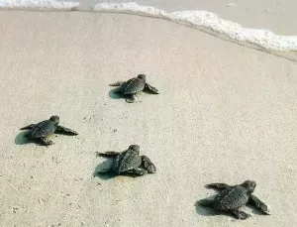
Individuals can act on information and communicate it to others. 1. Innate behaviors are behaviors that are inherited.

Slide 46
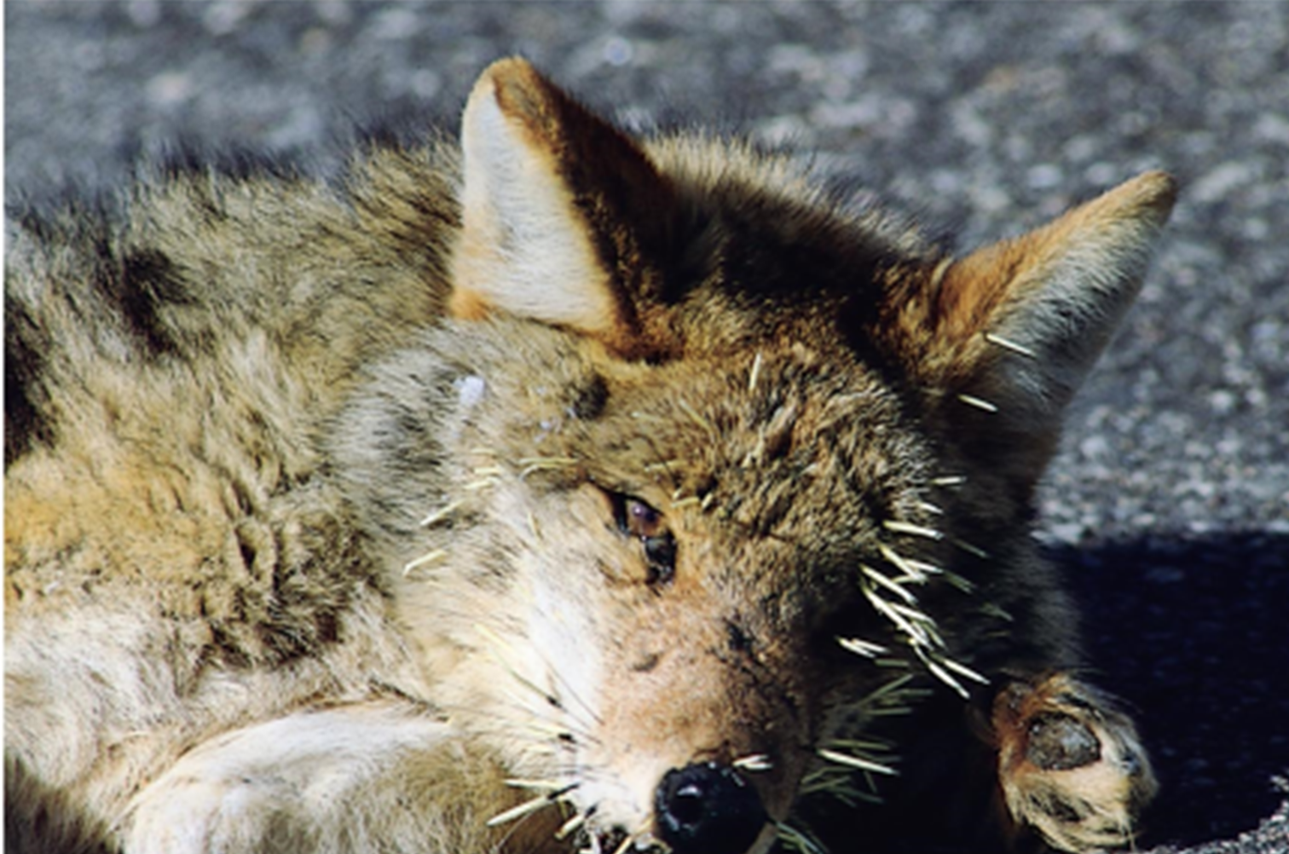
2. Learning occurs through interactions with the environment and other organisms.
I’ve learned not
to mess with
a porcupine
again!

Slide 47
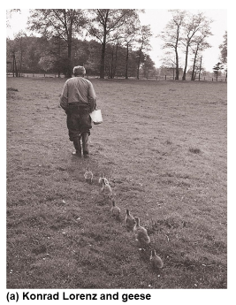
Konrad Lorenz - Often considered the founder of ethology (science of animal behavior) Studied imprinting. The geese in the photo imprinted on Lorenz’s boots when they hatched and followed them around like they would follow their mother.

Slide 48
Animals communicate by using pheromones, a chemical substance produced and released into the environment by an animal, especially a mammal or an insect, affecting the behavior or physiology of others of its species.

Slide 49
Signals released by one cell type can travel long distances to target cells of another cell type. 1. Endocrine signals are produced by endocrine cells that release signaling molecules, which are specific and can travel long distances through the blood to reach all parts of the body.

Slide 50
Examples: • Insulin • Human growth hormone • Thyroid hormones • Testosterone • Estrogen

Slide 51
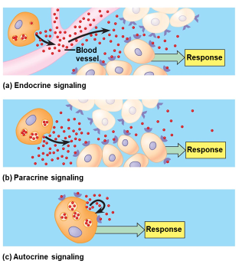

Slide 52
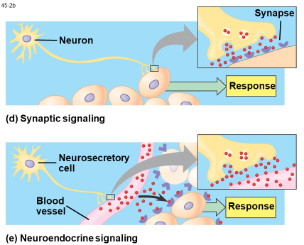

Slide 53
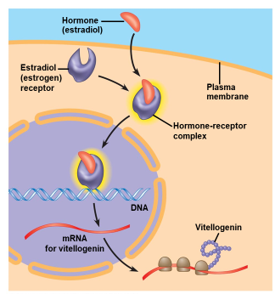

Slide 54
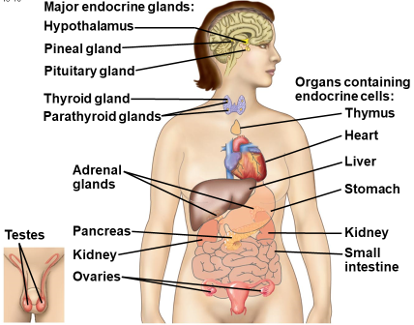

Slide 55
Communication occurs through various mechanisms. Living systems have a variety of signal behaviors or cues that produce changes in the behavior of other organisms and can result in differential reproductive success.

Slide 56
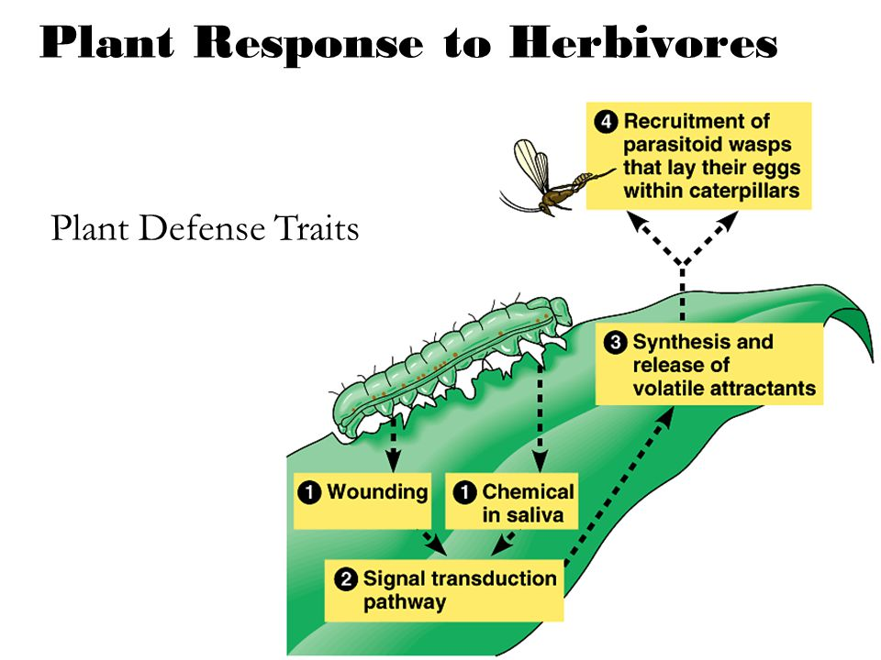
Examples: • Herbivory responses • Territorial marking in mammals • Coloration in flowers

Slide 57
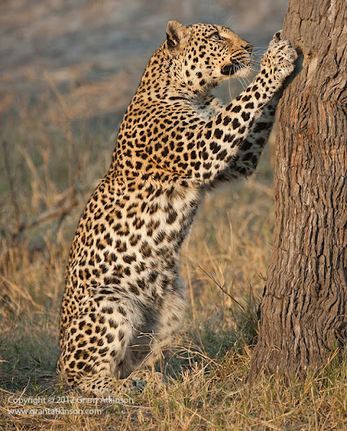
Animals use visual, audible, tactile, electrical and chemical signals to indicate dominance, find food, establish territory and ensure reproductive success.
I’m marking my territory by scratching on this tree.

Slide 58
Examples: • Bee dances • Birds songs • Territorial marking in mammals • Pack behavior in animals • Herd, flock, and schooling behavior in animals • Predator warning • Colony and swarming behavior in insects • Coloration

Slide 59
Fruit fly courtship behavior

Slide 60
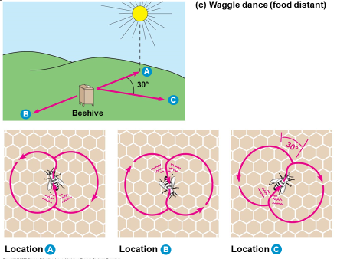
Waggle dance by bees to tell other members of the hive where to find nectar

Slide 61
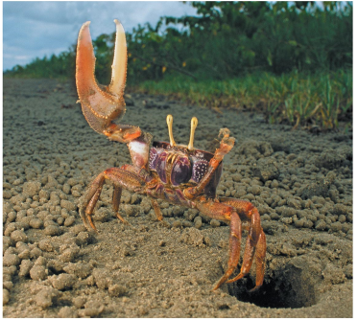
I need a girlfriend! See my cheliped??

Slide 62
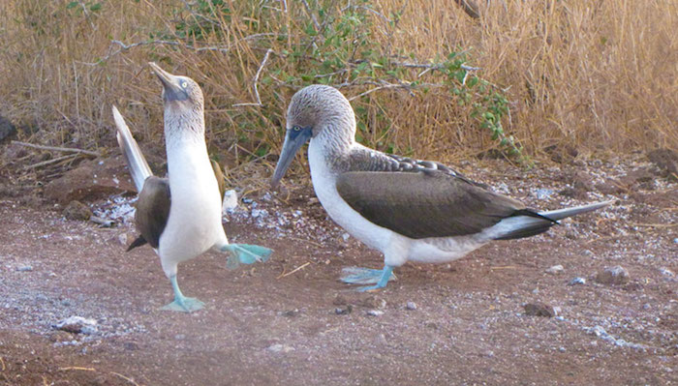
I’m hoping she’ll like my blue feet.

Slide 63
Cooperative behavior tends to increase the fitness of the individual and the survival of the population. (Female naked mole rats will not reproduce to take care of the queen’s offspring.

Slide 64
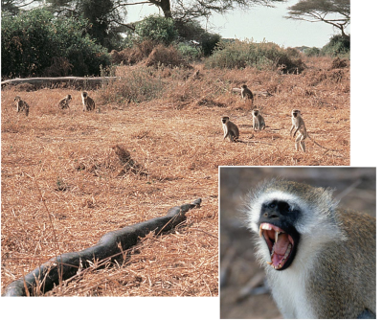
Altruistic behavior- I’ll sacrifice myself to protect you
There’s a giant snake…run!!!

Slide 65
Timing and coordination of specific events are necessary for the normal development of an organism, and these everts are regulated by a variety of mechanisms. b. Induction of transcription factors during development results in sequential gene expression. 1. Homeotic genes are involved in developmental patterns and sequences.

Slide 66
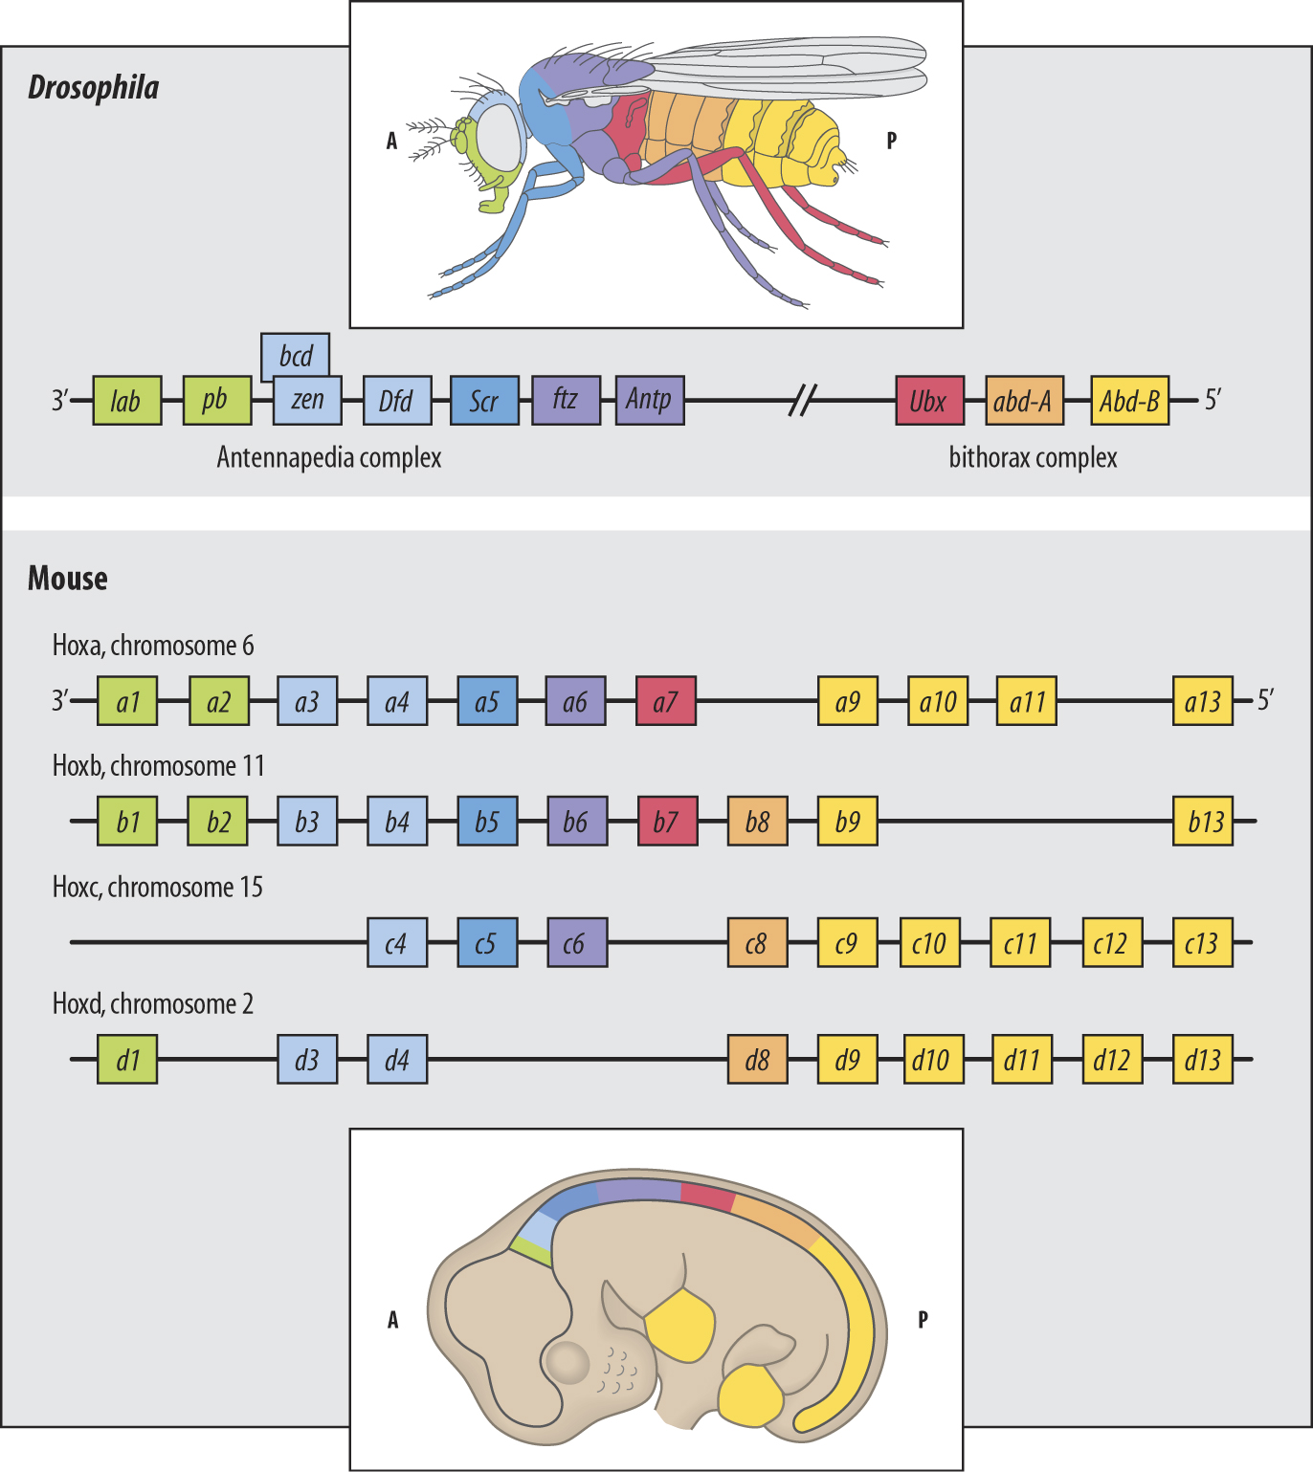
Homeotic genes that determine the body parts of a fruit fly embryo

Slide 67
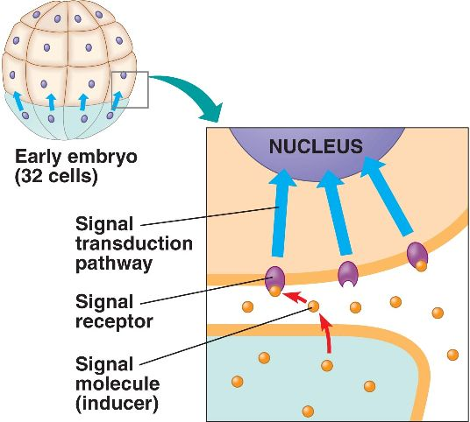
2. Embryonic induction in development results in the correct timing of events.
One group of embryonic cells
influences the development of
another, usually causing changes in
gene expression.

