Slide 1
Survival and reproductive success in observed in 3 types of adaptations:
Behavioral
Structural
Reproductive

Slide 2
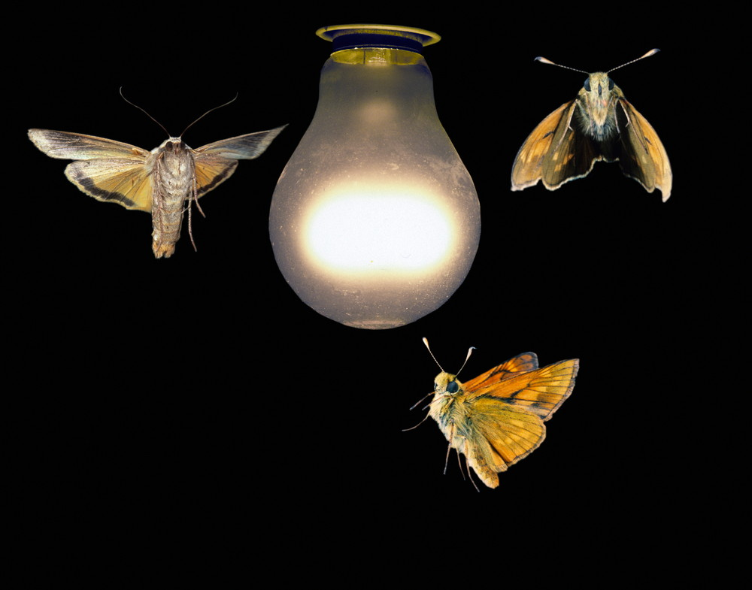
Taxis – MOVEMENT OF ORGANISMS TOWARD OR AWAY FROM A STIMULUS
BEHAVIORAL ADAPTATIONS THAT ALLOW FOR SURVIVAL AND SUCCESS

Slide 3
MALE ATTRACTED TO FEMALE BY CHEMICAL RELEASED CALLED PHEROMONES

Slide 4
FISH SWIM WITH CURRENT

Slide 5
ANTS MOVING TOWARD SUGAR

Slide 6
A SNAIL MOVES AWAY FROM THE SUN TO STAY MOIST

Slide 7
Plants move toward light

Slide 8
https://lazyop.com/adult-venus-flytrap/

Slide 9
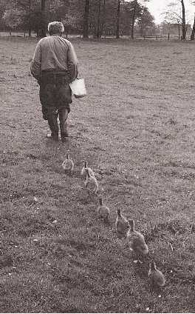
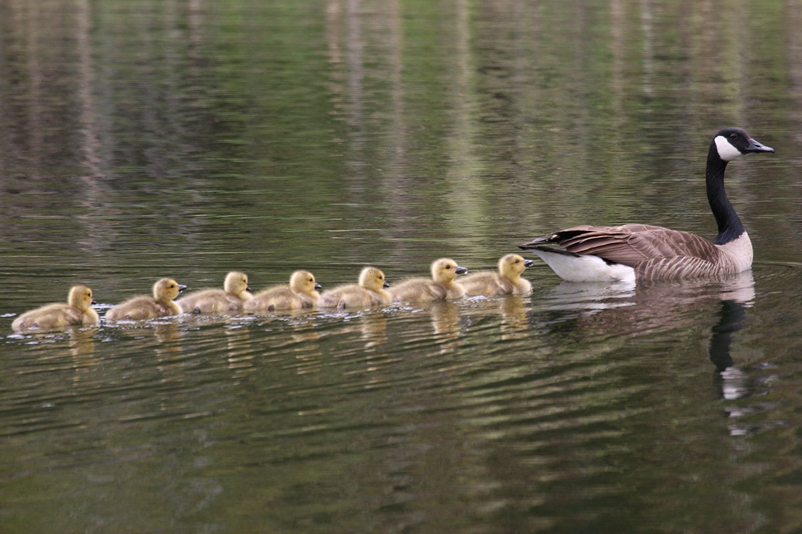
IMPRINTING – A YOUNG ANIMAL RECOGNIZES A PARENT

Slide 10
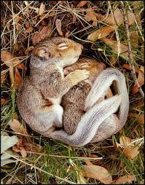
ESTIVATION AND
HIBERNATION – DECREASE
IN MOVEMENT TO RESERVE
ENERGY OR ESCAPE A
NEGATIVE ENVIRONMENTAL
FACTOR (SUCH AS HEAT)

Slide 11
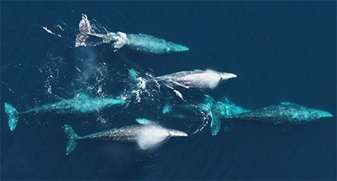
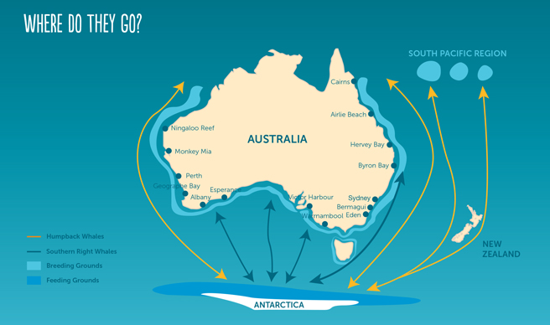
WHALE MIGRATION
MIGRATION – SEASONAL MOVEMENT OF ANIMALS TO FIND MATES AND/OR FOOD

Slide 12
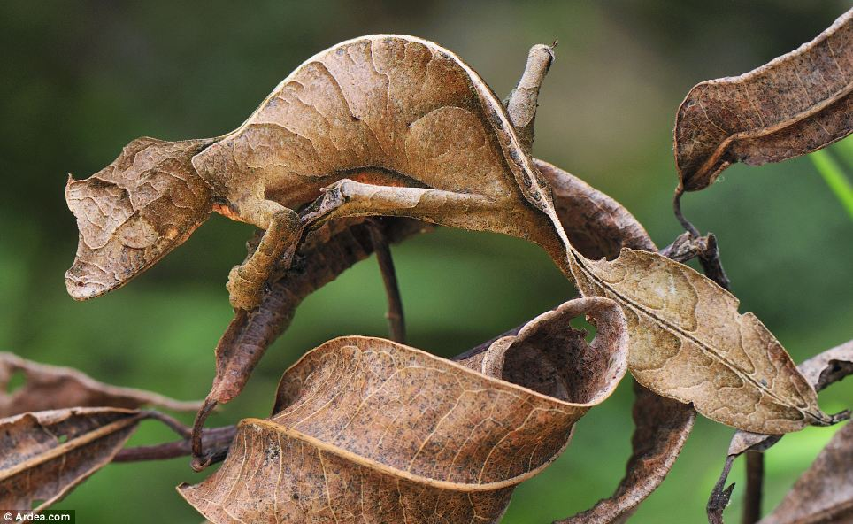
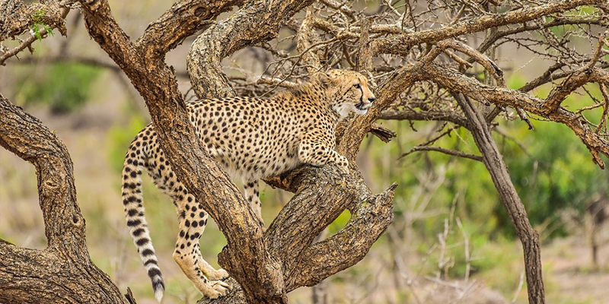
STRUCTURAL ADAPTATIONS ENSURE SURVIVAL AND SUCCESS
CAMOUFLAGE

Slide 13
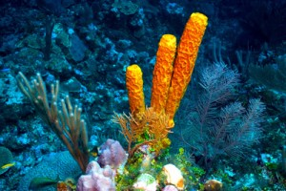
METHODS OF OBTAINING FOOD
SPONGES ARE FILTER
FEEDERS

Slide 14
SO ARE SOME TYPES OF WHALES

Slide 15
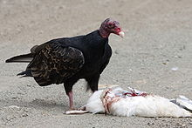
SOME ORGANISMS FEED ON DEAD MATTER (DETRItiVORES AND DECOMPOSERS)

Slide 16
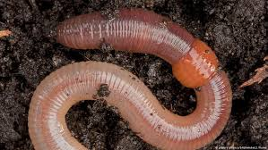
TYPES OF RESPIRATION
SOME ANIMALS RESPIRE
THROUGH THEIR SKIN

Slide 17
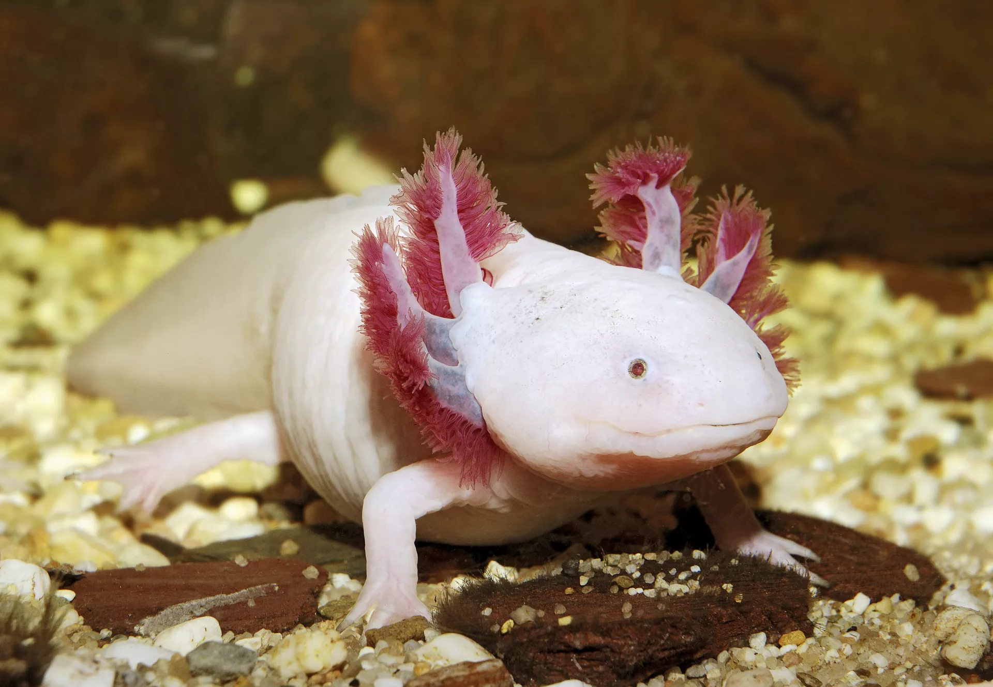
SOME ANIMALS HAVE
GILLS

Slide 18
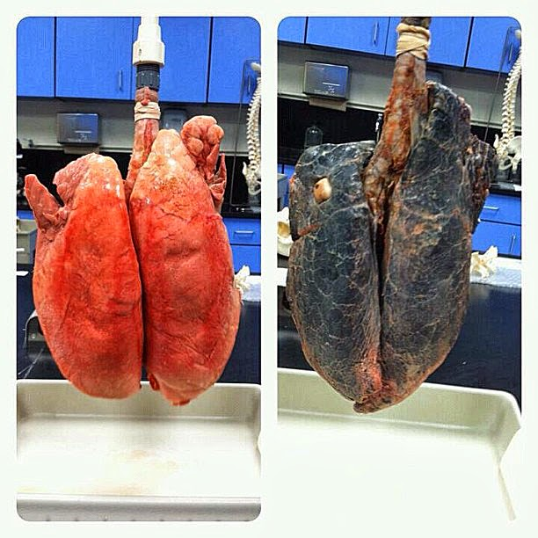
SOME ANIMALS
HAVE LUNGS

Slide 19
REPRODUCTIVE ADAPTATIONS ALLOW FOR EVOLUTIONARY SUCCESS
Asexual reproduction – offspring have one parent
Sexual reproduction – offspring have two parents

Slide 20
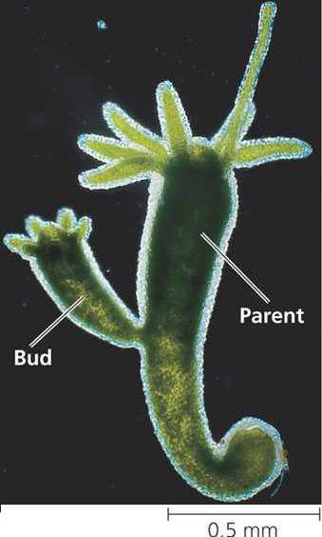
Hydra produce a bud
which breaks off to
produce an offspring
(genetically
Identical to parent)

Slide 21
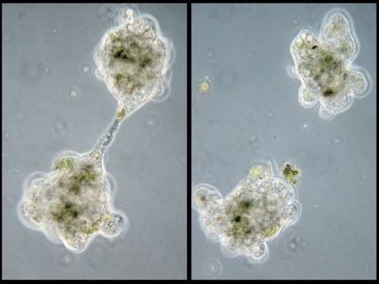

Slide 22
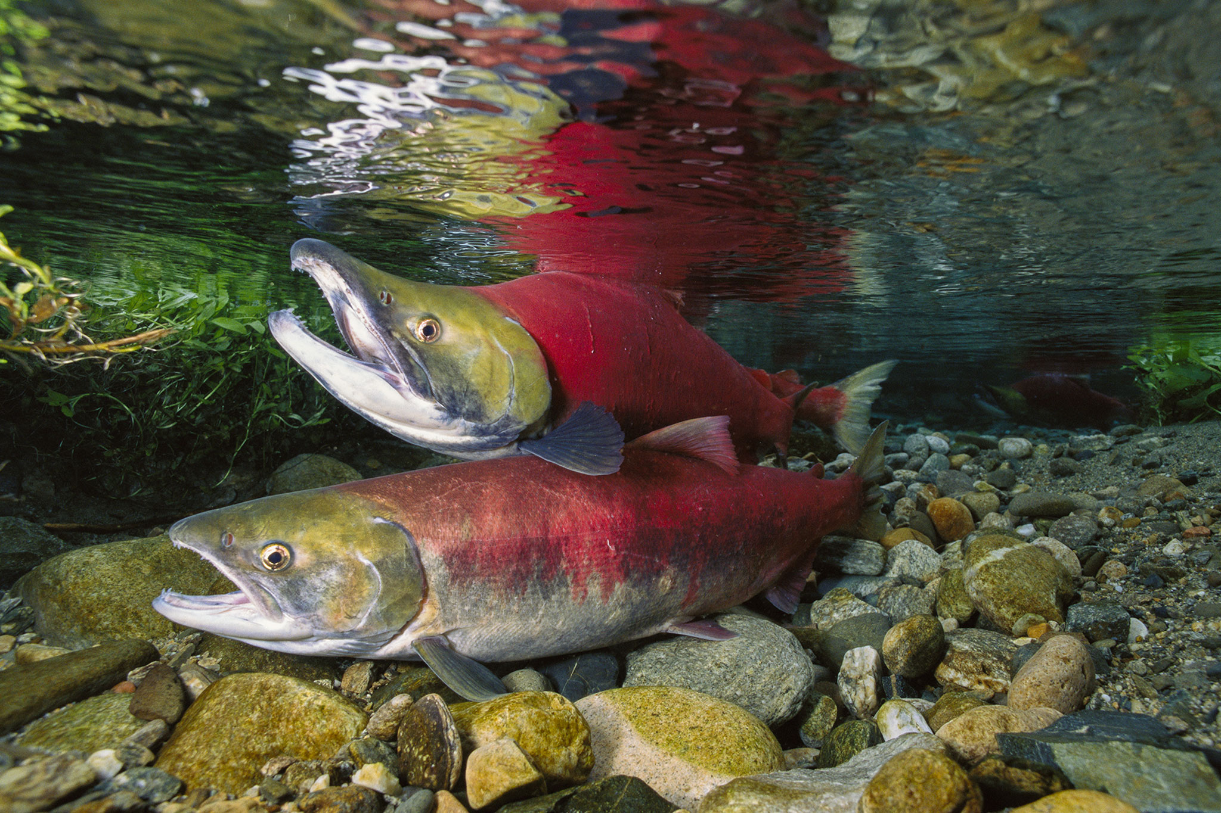
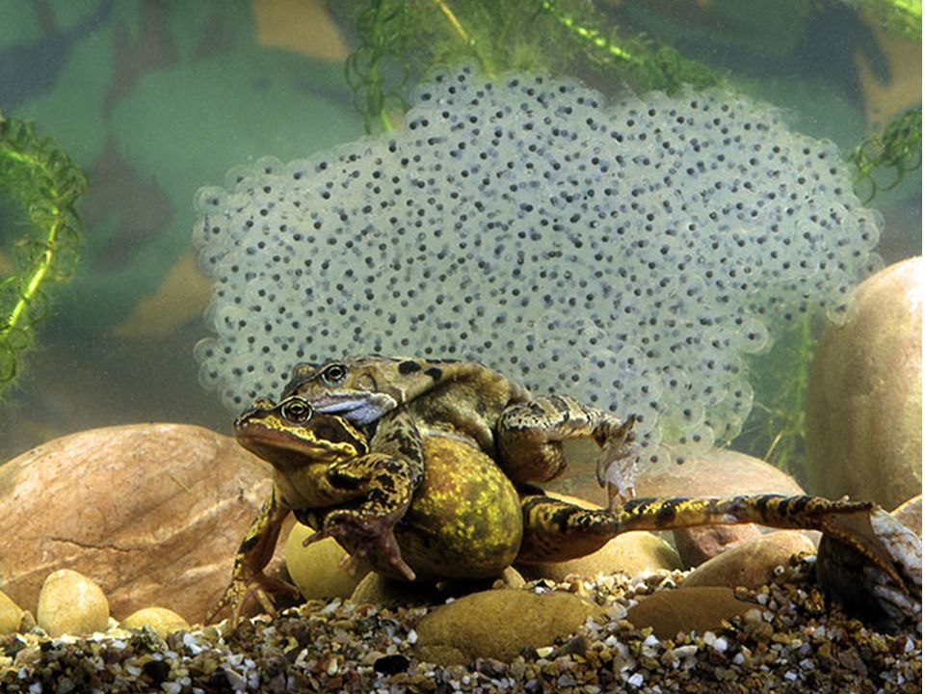
Internal vs external fertilization
Frogs and
some
fish fertilize
externally

Slide 23
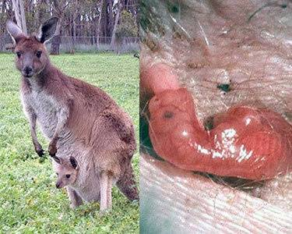
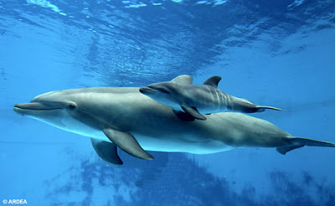
Placental
mammals –
give birth to
young and
care for them

