Slide 1
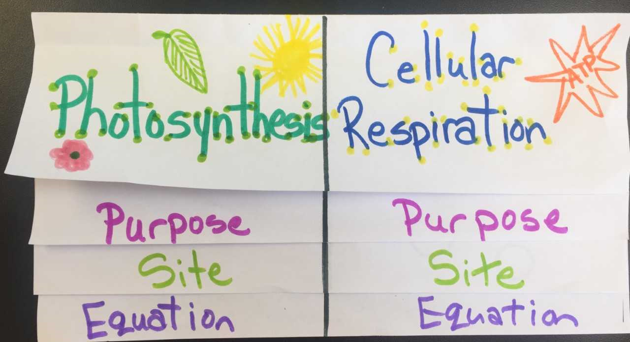
Photosynthesis VS Cellular Respiration Foldable

Slide 2
PURPOSE
PHOTOSYNTHESIS CELLULAR RESPIRATION
Use light energy to convert Release energy from
water (H₂O) and carbon dioxide glucose by breaking
(CO₂) into carbohydrates, such it down into useable
as glucose energy in a molecule
called adenosine
triphosphate (ATP)

Slide 3
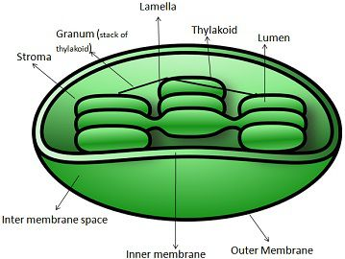
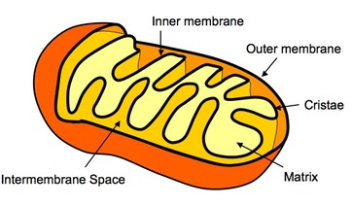
SITE OF PHOTOSYNTHESIS CELL RESPIRATION
CHLOROPLAST | MITOCHONDRIA
OCCURS IN PLANTS, ALGAE
AND SOME BACTERIA
OCCURS IN ALL ORGANISMS, INCLUDING
HETEROTROPHS AND AUTOTROPHS

Slide 4
EQUATION PHOTOSYNTHESIS CELLULAR RESPIRATION
6 H₂0 + 6 CO₂ → C₆H₁₂O₆ + 6 O₂ | C₆H₁₂O₆ + 6 O₂ → 6 H₂0 + 6 CO₂

Slide 5
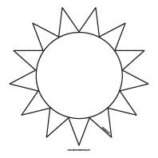
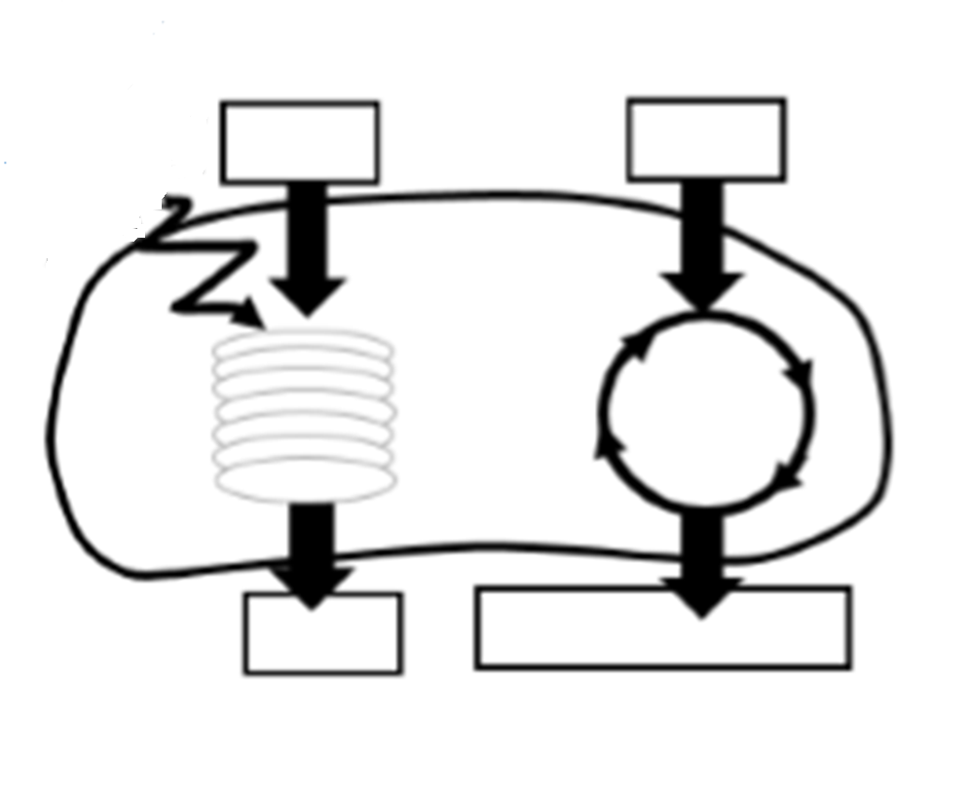

Slide 7
TWO TYPES OF CELLULAR RESPIRATION
Aerobic respiration requires oxygen and makes about 38 molecules of ATP per glucose molecule
(2) Anaerobic respiration does NOT require oxygen and makes 2 molecules of ATP per glucose molecule

Slide 8
We go through a type of anaerobic respiration called lactic acid fermentation during exercise

Slide 9
Some organisms go through anaerobic respiration called ethyl alcohol fermentation

