Slide 1
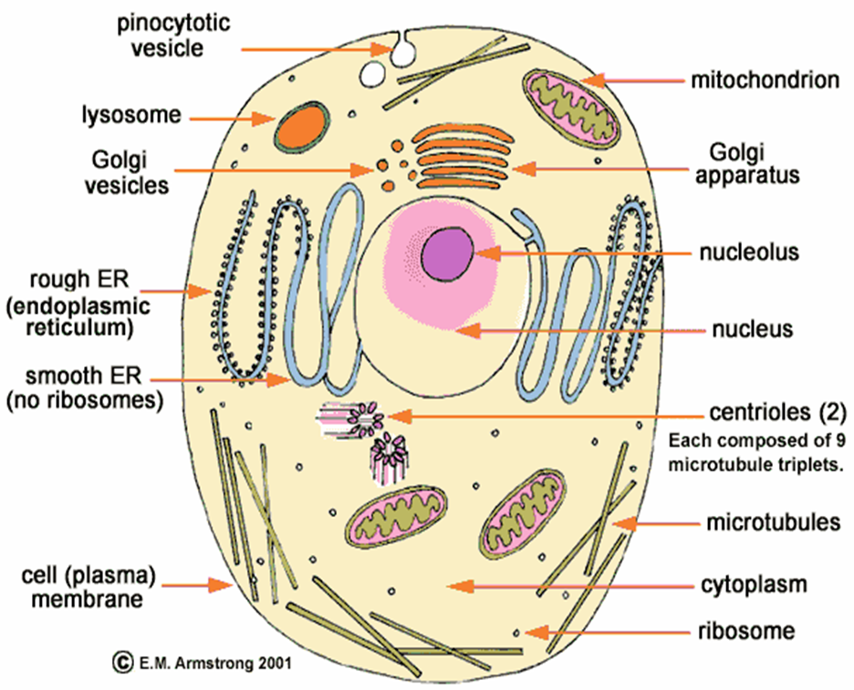
ORGANELLES
This PowerPoint focuses primarily on EUKARYOTIC organelles

Slide 2
CELL (PLASMA) MEMBRANE
Composed of two layers of lipids and protein
Encloses the cell
Regulates the passage of materials between the cell and its environment

Slide 3
CYTOPLASM
Semi-fluid material found between all organelles outside the nucleus

Slide 4
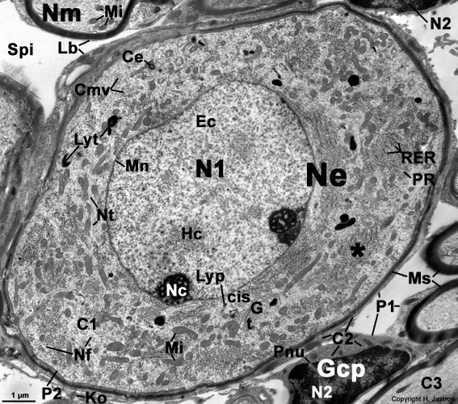

Slide 5
CYTOSKELETON
Protein fibers and tubes that extend throughout the cell; made of microtubules and microfilaments
Provide support and shape to the cell

Slide 7
NUCLEUS
Usually located in the cell’s center
Surrounded by a nuclear membrane (or envelope) with small pores
Contains chromosomes made of DNA
Genetic control over the cell

Slide 9
RIBOSOMES
Very small organelles
Not membrane bound
Found on the surface of the ER or free in the cytoplasm
Site of protein synthesis

Slide 11
ENDOPLASMIC RETICULA (ER)
Network of membranous tubes throughout the cytoplasm
Transports materials (usually protein)
Rough ER has ribosomes; smooth ER doesn’t have ribosomes

Slide 13
GOLGI (apparatus, complex or body)
Made of curved, stacked membranes
Modifies, collects, packages, and distributes molecules (usually protein) within the cell or out of the cell

Slide 14
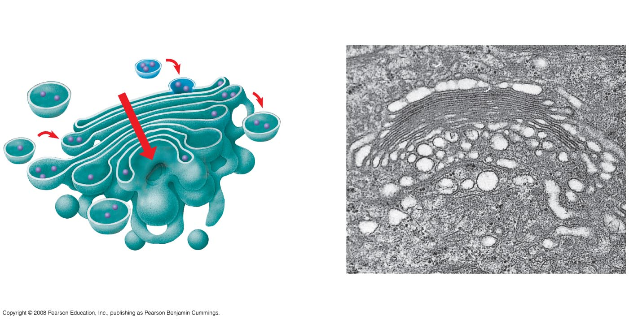

Slide 15
VACUOLES
Membrane-bound storage compartments (for food, water, etc.)
Plant cells usually have a large, central water vacuole

Slide 17
LYSOSOMES
Membrane-bound organelles filled with digestive enzymes
Break down food and worn out organelles

Slide 18
MITOCHONDRIA
Located throughout cytoplasm
Two membranes – an outer, smooth membrane and an inner, folded one
Contains DNA
Site of cellular respiration (energy in food is converted into ATP)

Slide 19
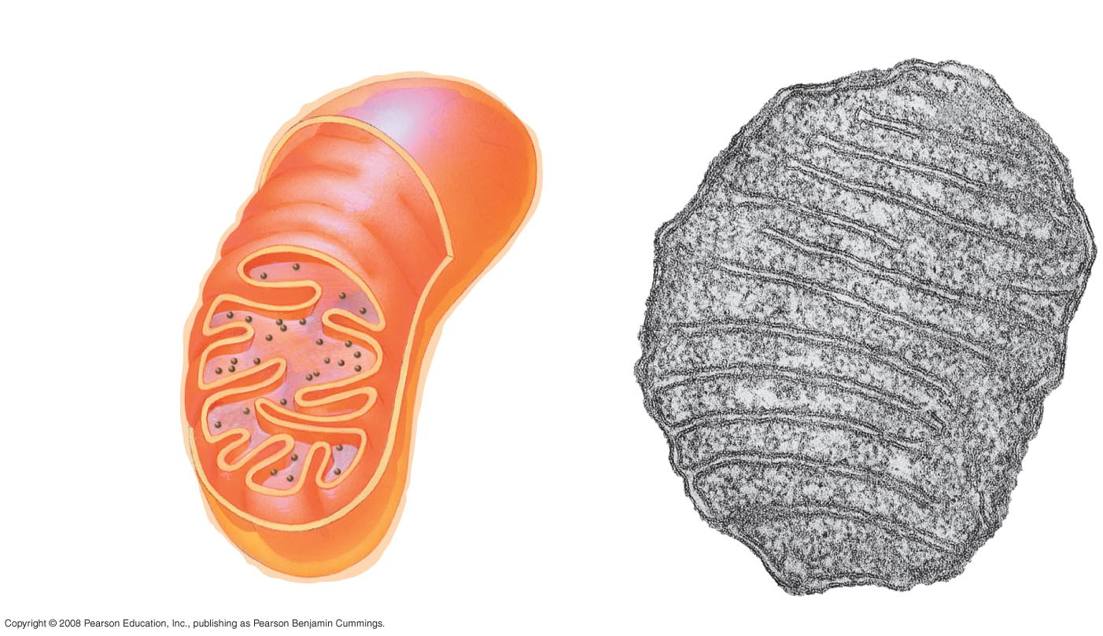

Slide 20
CHLOROPLASTS
Typically found in plant and algal cells
Surrounded by two membranes and a complex series of inner membranes organized in stacks
Contain chlorophyll (green)
Site of photosynthesis (energy from the sun converted to sugar)

Slide 21
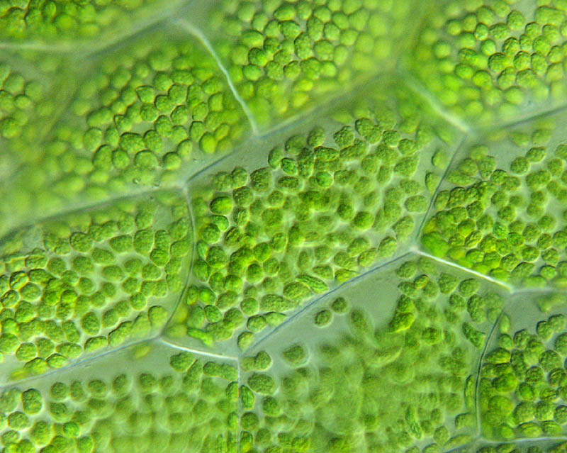

Slide 23
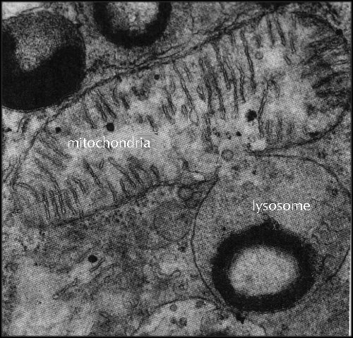

Slide 25
CELL WALL
Located outside the cell membrane in some cells
Provides protection and support

Slide 27
CILIA & FLAGELLA
Extend through the cell membrane to the outside of the cell
Flagella are long and tail-like; cells usually have 1 flagellum or few flagella
Cilia are shorter and numerous
Used in locomotion (swimming through the water), food getting, or filtering (such as the cilia on cells in your pharynx)

Slide 28
Paramecium with cilia

Slide 29
Trachea cells with cilia

Slide 30
Euglena with flagellum

Slide 31
Bacteria with flagella

Slide 32
PROKARYOTES
have no membrane bound organelles, including a nucleus
contain cytoplasm & ribosomes
unicellular
bacteria
DNA (which makes up chromosomes) is found in a nucleoid region
1 circular chromosome
some have a smaller, second chromosome called a plasmid

Slide 34
A prokaryotic bacterium

Slide 35
PROKARYOTES
Bacteria
Unicellular
Cell membrane (some have cell walls) enclosing cytoplasm with ribosomes and a single, circular chromosome called a plasmid

Slide 36
EUKARYOTES
Can be unicellular, but most are multicellular
Plants, animals, fungi, and protists (mostly unicellular eukaryotes such as amoeba, paramecia, algae)
DNA organized into circular chromosomes found in the nucleus
Contain membrane bound organelles – vacuoles, lysosomes, Golgi, ER, etc.

