Slide 1
HUMAN GENETIC DISORDERS
Caused by mutations either during DNA replication (gene mutations) or meiosis (chromosome mutations)

Slide 2
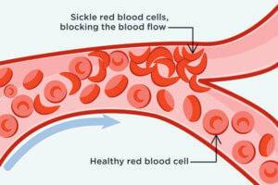
SICKLE CELL (ANEMIA)
Red blood cells are “sickle shaped”
Causes blood clots and lack of
oxygen to cells

Slide 3
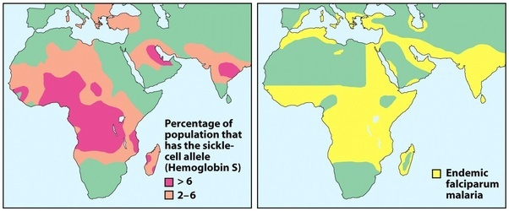
SICKLE CELL (protection against malaria)
Common mutation among

Slide 4
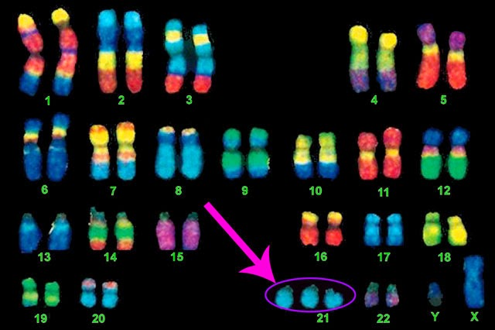
DOWN’S
Caused by nondisjunction
(chromosomes do not
separate during meiosis)
Causes an extra 21st
chromosome
(trisomy 21)
Mental retardation, rounded face,
large tongue

Slide 5
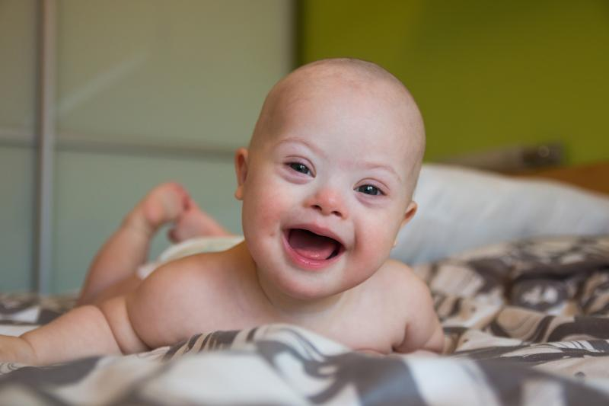
DOWN’S

Slide 6
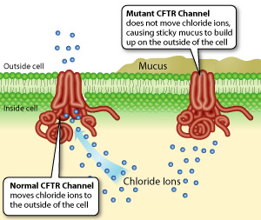
CYSTIC FIBROSIS (CF)
Deletion mutation in
membrane protein
for the diffusion of
Cl⁻
Causes thick mucus
that clogs lungs and
intestines

Slide 8
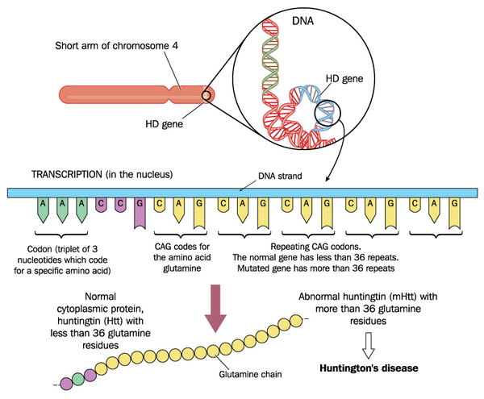
HUNTINGTON’S
Repeat
mutation
(CAG is repeated)
Kills cells of the
brain
Symptoms don’t
appear until later

Slide 9
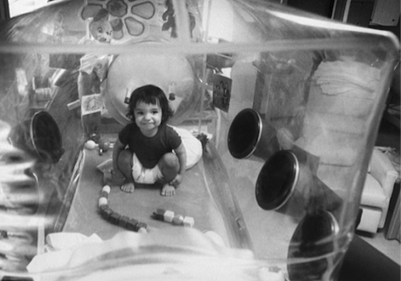
SEVERE COMBINED IMMUNODEFICIENCY (SCID)
Mutation in gene for
making protein
necessary
for white blood cells
to function
Severely affected immune systems

Slide 10
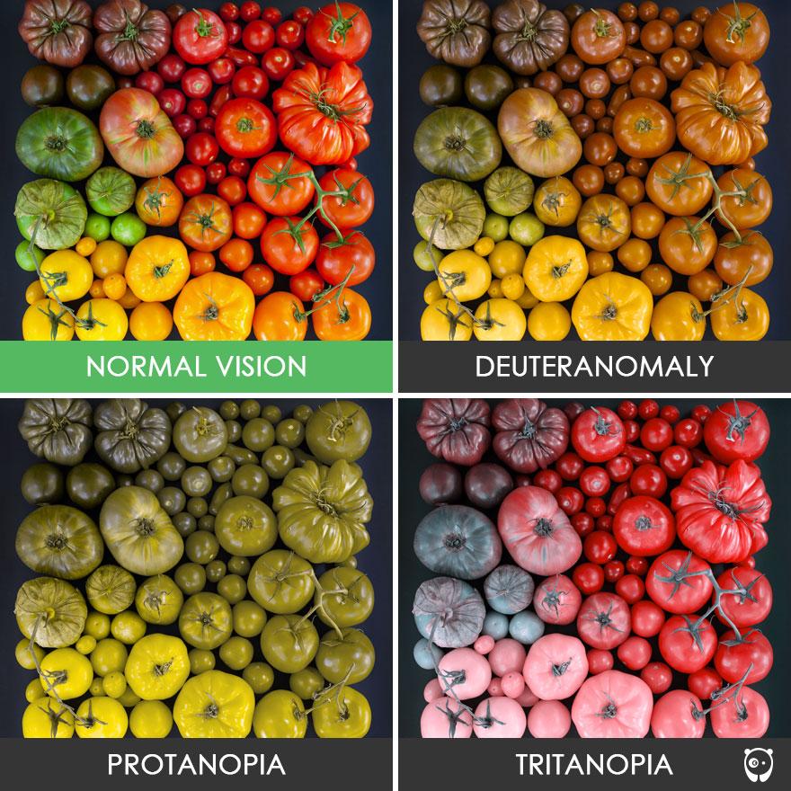
COLOR BLINDNESS
Affects cells in the
retina of the eye
Causes difficulty in
seeing specific colors

Slide 11
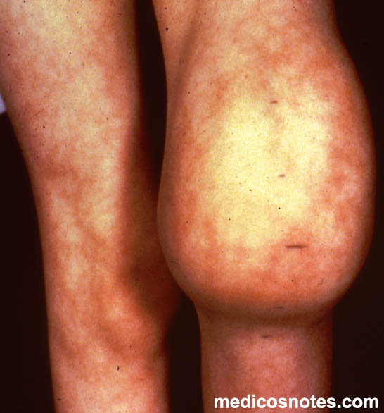
HEMOPHILIA
Mutation in protein
necessary for blood
clotting called
Factor VIII
Causes excessive
bleeding

